Slide 1
Traffic Modelling System
Team B - Ekathra
Ashwini Cherukuri
Rupanandha Moori
Sahil Nokhwal
Rama Naveen Kommuri
Laxmi Sai Teja Naraharasetty
Vamsi Chowdary Bobba
Manikanta Nomula

Slide 2

Client and Mentor
Client & Mentor: Dr. Michael Oudshoorn
Associate professor in the School of Computer Science and Information System

Slide 3
Outline :
Project Overview
Prototypes
Requirements
Use cases
Project management plan
Software Architecture Thoughts
Challenges Faced
Tools & Technology

Slide 4
Project Overview:
Problem :Traffic congestion is a main problem in most of the cities on popular streets and on Inter state highways.
Goal: To build a system with discreet event traffic simulation capabilities .Which enables users to make some predictions.
Success Criteria : System should accommodate all the mentioned requirements by the client and should produce the desired output as per the use cases.

Slide 5
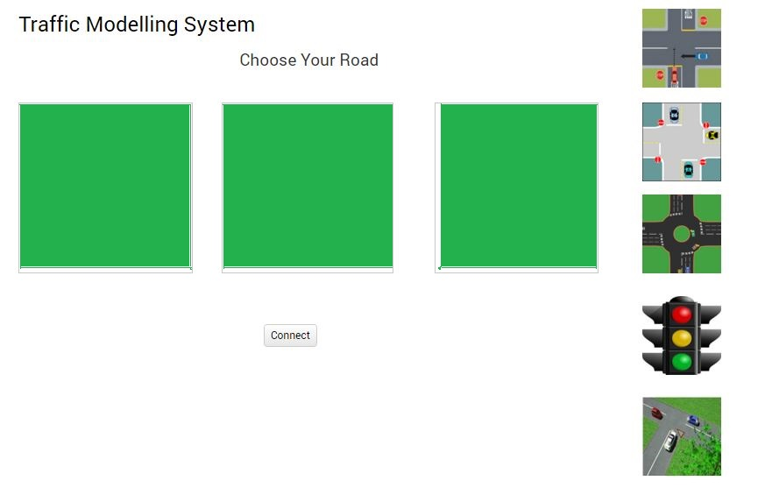
Prototypes :
System allows user to choose the combinations he want.
He just need to drag different roads into the boxes shown.
Connect button helps to join the roads.

Slide 6
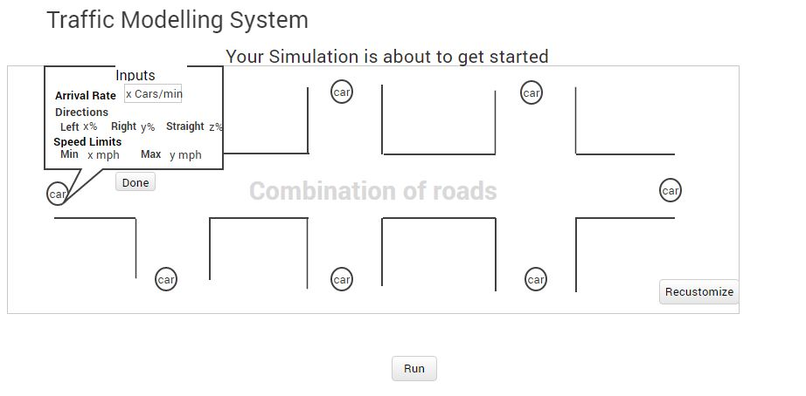
Prototypes(Contd..)
After connecting the roads, user provide the inputs to the car generator to generate the cars or re-customize the roads combinations if he wants to.

Slide 7
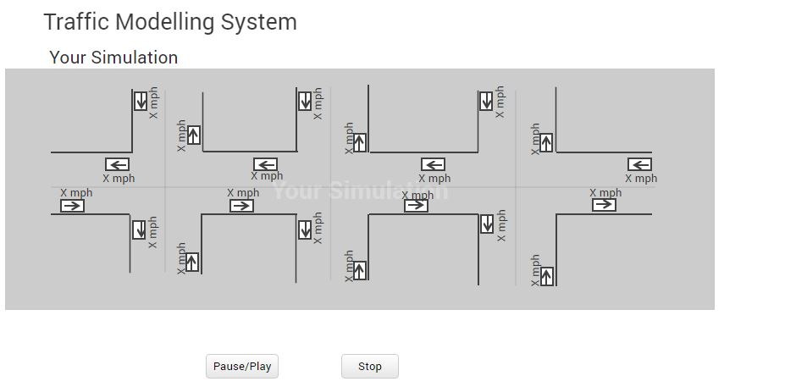
Prototypes(Contd..)
Run button stats the simulation.
User can pause/pay/stop

Slide 8
Requirements
User should be able to drag and drop different types of roads which include 2-ways, 4-ways, roundabouts, traffic signals and T-junction depends on the user choice.
System should allow user to connect edit combination of roads and these roads are one dimensional.
System should allow user to load the default/stored values from file and should allow user to edit the values depends on the requirement.
The user should provide the below details to generate the cars.
Arrival rate.
Speed limit of the road, which will be a range. Ex- 60-65 mph.
Distance of the roads.
Distance between the vehicles.

Slide 9
Requirements (Contd..)
Car should choose the direction of travel at intersections randomly based on percentages allocated.
The cars should maintain some threshold distance among them to avoid accidents.
Speed of the cars should (+,-) 10 to 5 miles depends on the road.
The cars should come in all directions and in different speeds.
Cars in the simulation panel should indicate the direction of travel and the speed of travel.
System should capture the info about the traffic(Number vehicles generated and which direction most vehicles travelled and the average time of travel).
Car should destroy after reaching destination.

Slide 10
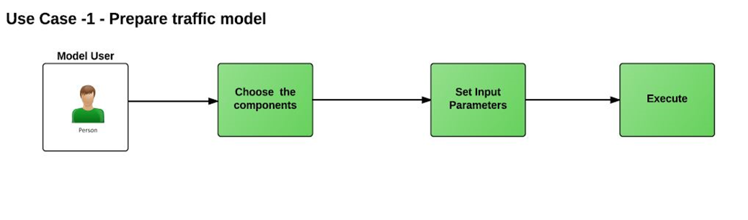
Use Case:

Slide 11
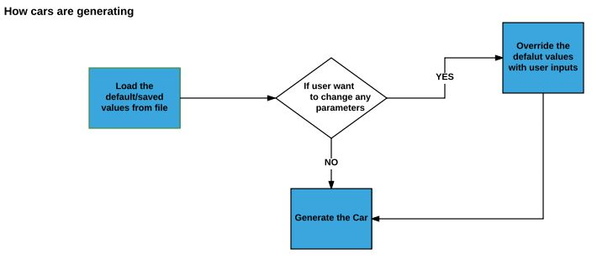
Use Case(Contd..)

Slide 12
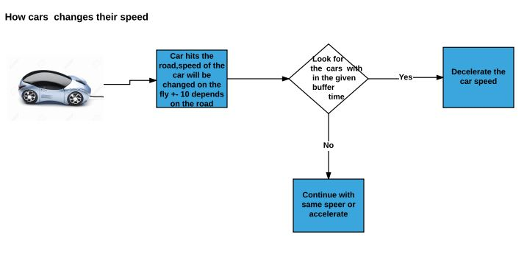
Use Case(Contd..)

Slide 13
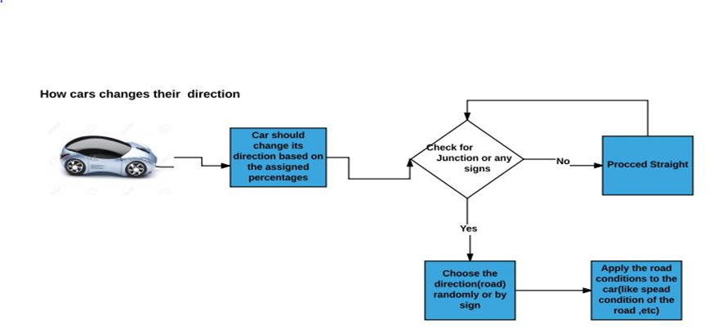
Use Case(Contd..)

Slide 14
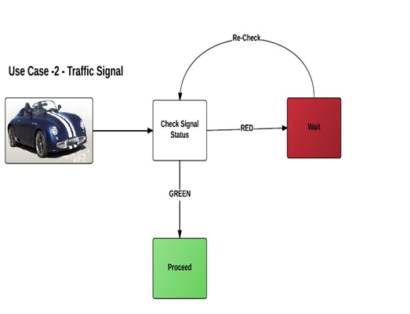
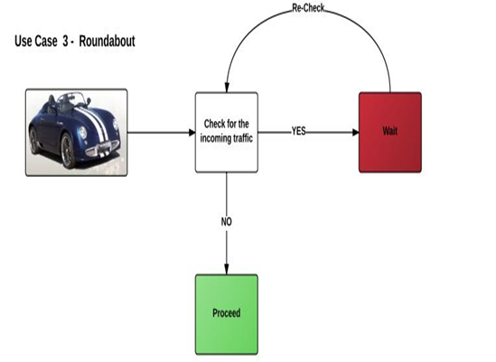
Use Case(Contd..)

Slide 15
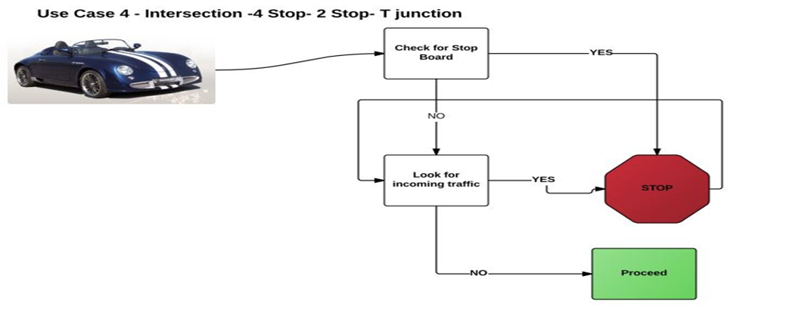
Use Case(Contd..)

Slide 16
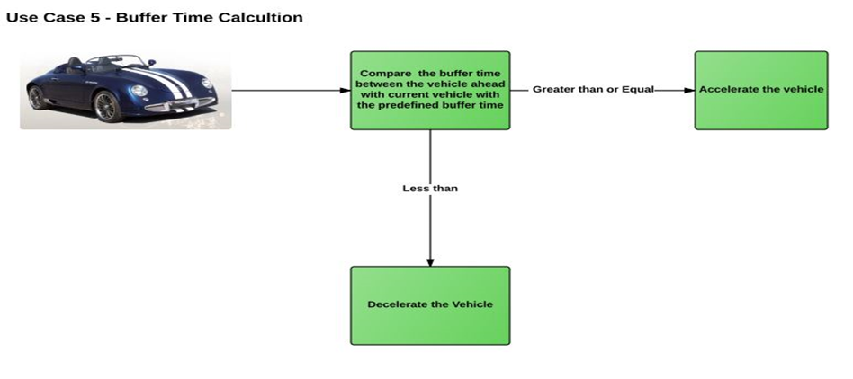
Use Case(Contd..)

Slide 17
Project Management Plan:
Budget Allocation: We are measuring the budget in terms of time spent on the project. Each person will spend about 2 hours each day in weekdays and in weekends we will have team meetings of duration 2 hours. We will be attending the client meeting of 1 hour in a particular week which makes a total of 15 hours. For each person
How we calculated hours: ur estimation for this project would 8000 approximate lines of code. We are considering 8000 lines of code through after reading/observing existing systems. We have discussed lines of code with some employees and came to get this figure through them.
Avg. person writes 115 lines of code per week
Therefore a person requires 10 hours of work per week and 5 hours of meeting. So the total would be 15 hours of work per week.

Slide 18
Project Management Plan (Contd..)
Weekdays: 5 X 2 = 10
Weekend team meetings: 2 X 2 = 4
Client meeting: 1 X 1 = 1
Total: 15 hours
So we are spending about 15 hours per person per week which makes a total of 15X7 = 105 hours per week per team. So the total budget of the project is 85X24 = 2520 (26 is the total number of weeks in both GDP 1 and GDP 2).
Per week per person: 15 X 1 = 15
Per week per team: 15 X 7 = 105
Total hours per team: 85 X 26 = 2730 hours.
Here 26 is the total number of weeks the project is going to take.

Slide 19
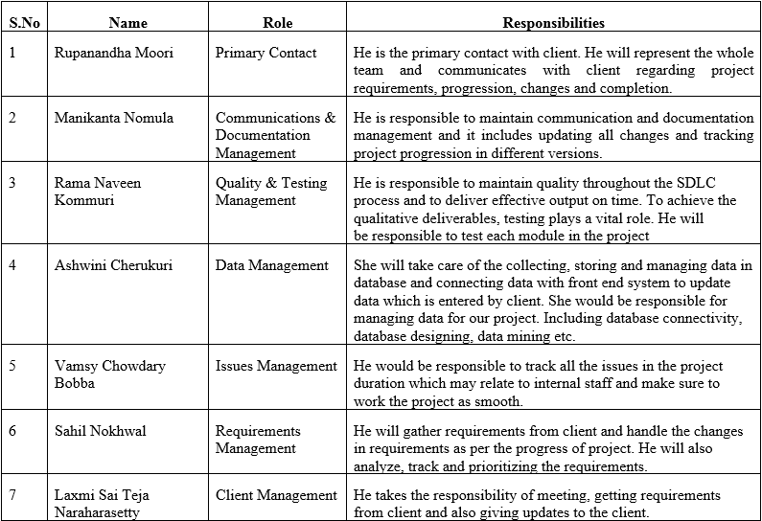
Project Management Plan (Contd..)
Schedule: The project started on
09/01/16 and it will be completed
by 04/10/17 and detailed
information of the schedule
will be in schedule management plan.

Slide 20
Software Architecture thoughts:
A software architecture is one of the first steps towards a software system. A software architecture can be designed in different ways. During the design phase, it is important to select the most suitable design of the architecture, in order to create a good foundation for the system. The selection process is performed by evaluating architecture alternatives against each other. We investigate the use of continuous simulation of a software architecture as a support tool for architecture evaluation. For this purpose, we study a software architecture of an existing software system in an experiment, where we create a model of it using a tool for continuous simulation, we identify that we need discrete functionality to be able to correctly simulate the system, and that it is very time-consuming to develop a model for evaluation purposes.

Slide 21
Challenges Faced:
Lack of system thinking.
Communication gaps exist between the team member and with client.
Requirements change during the course of the project.
Lack of understanding on the behavior of current system.
Scope changes.
Limited knowledge on the technical areas.

Slide 22
Tools & Technologies:
Java/Swing
Eclipse/Net Beans
Gant Charts

Slide 23

Any Queries?

Slide 24

Thank You!

